Slide 1


Human Hand
Exo-Prosthesis
UNIVERSITÀ DEGLI STUDI DI NAPOLI FEDERICO II, NAPOLI, ITALY

Slide 2
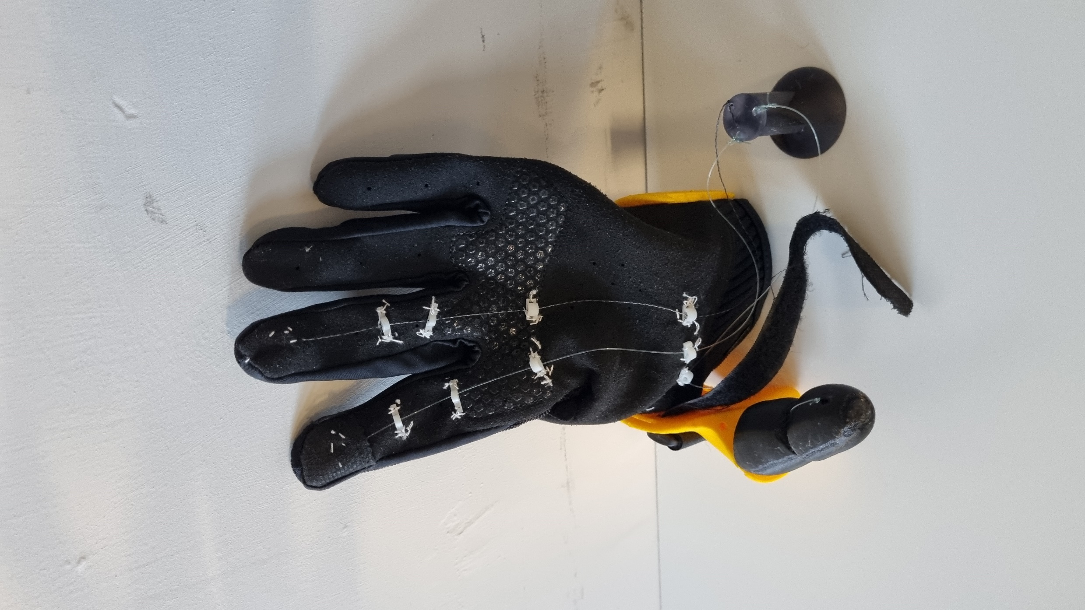
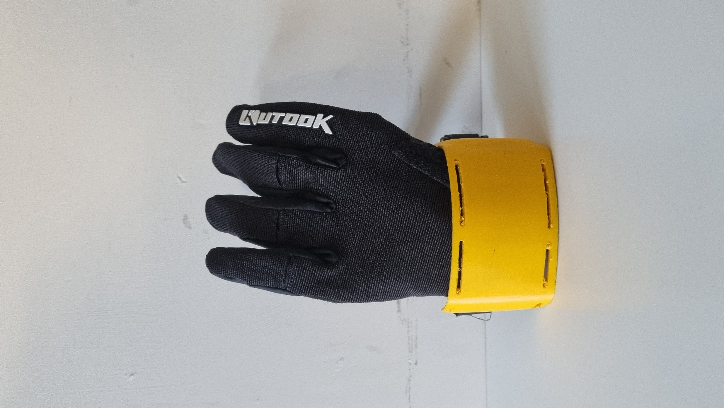
COMPONETS
Lycra Glove
Hand Support
3D Printed
Patient-shape
Prostethis Thumb
3D Printed
Tendon actuation
Antagonist action based on the intrinsic material stiffness

Slide 3
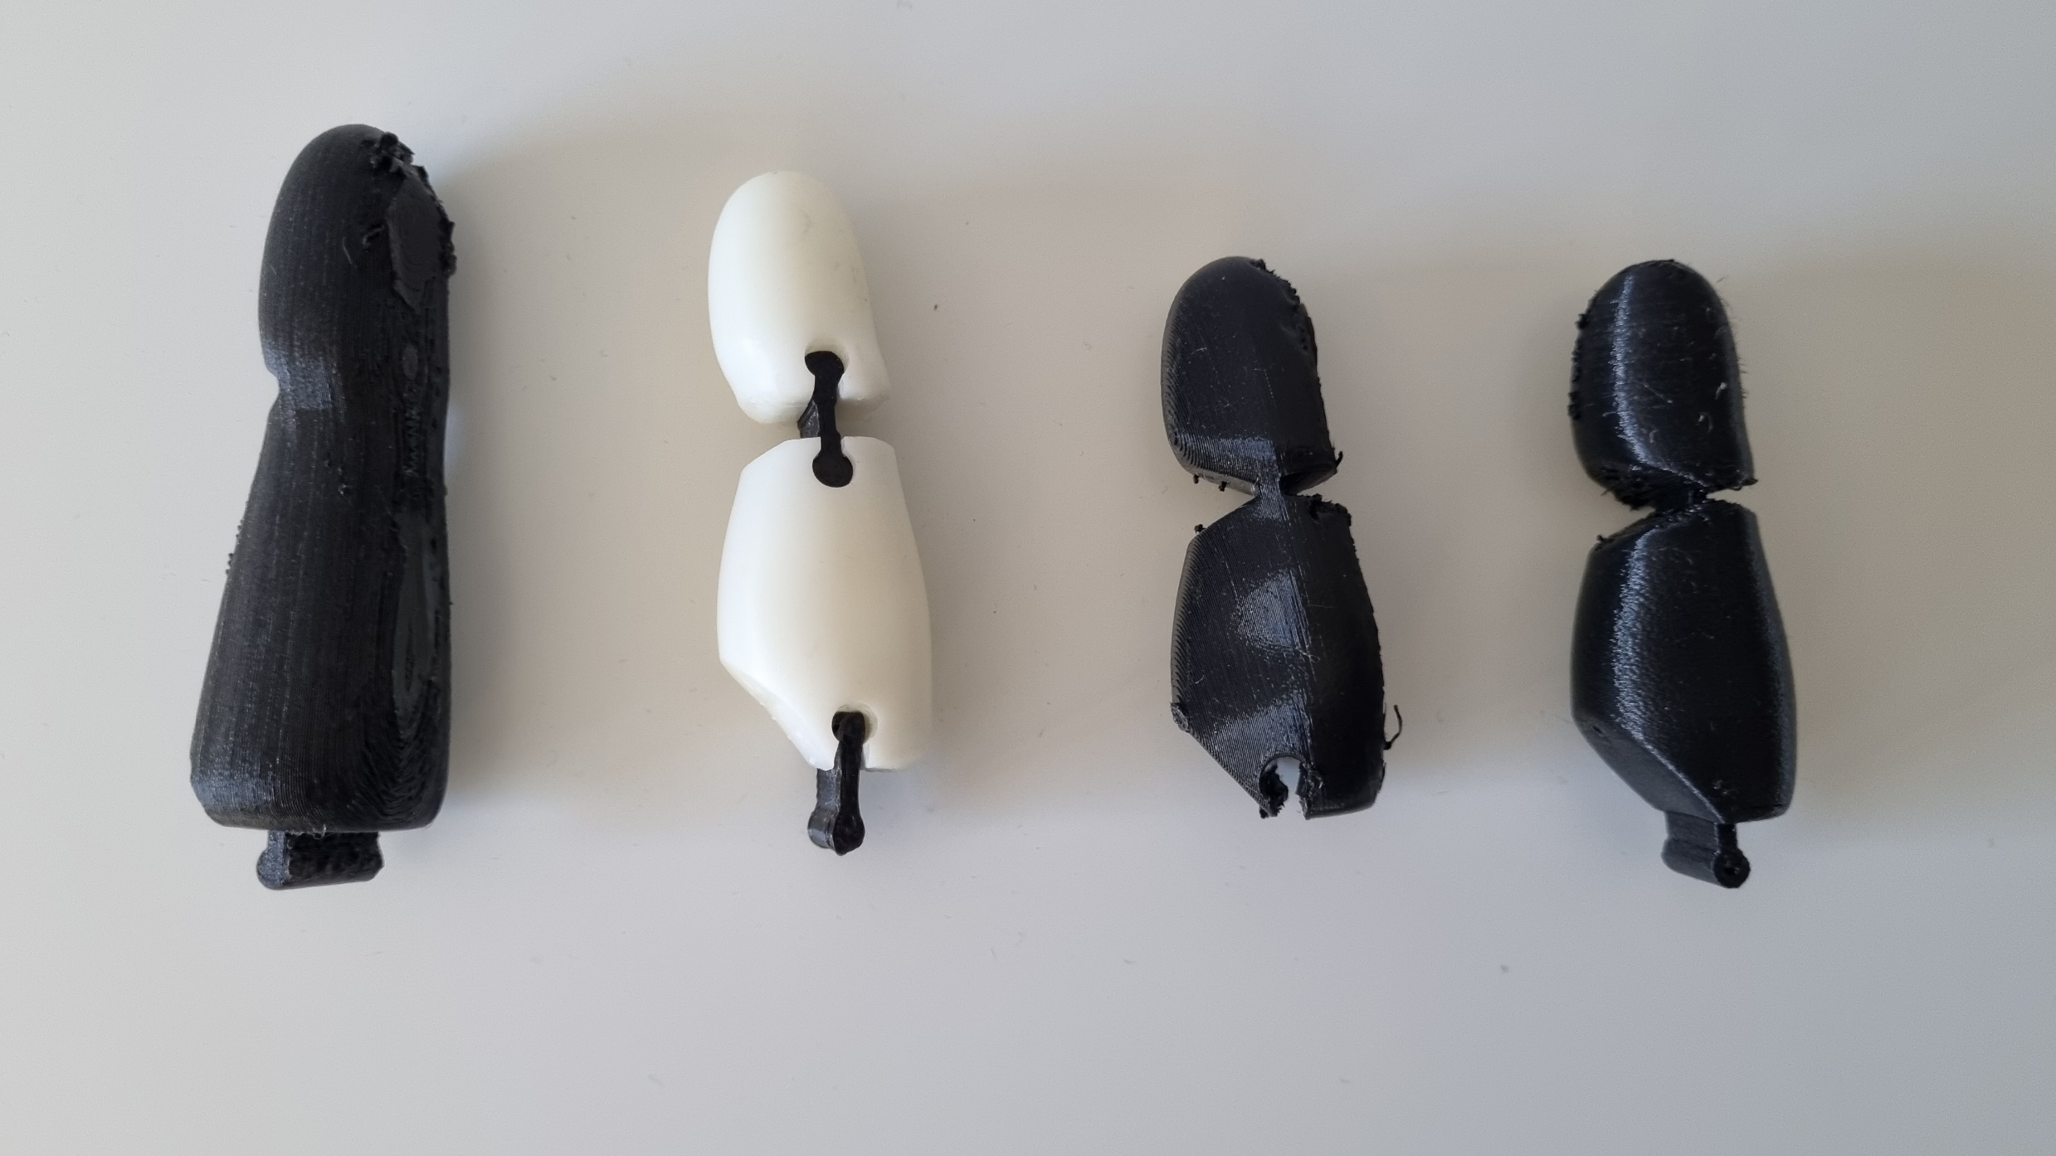
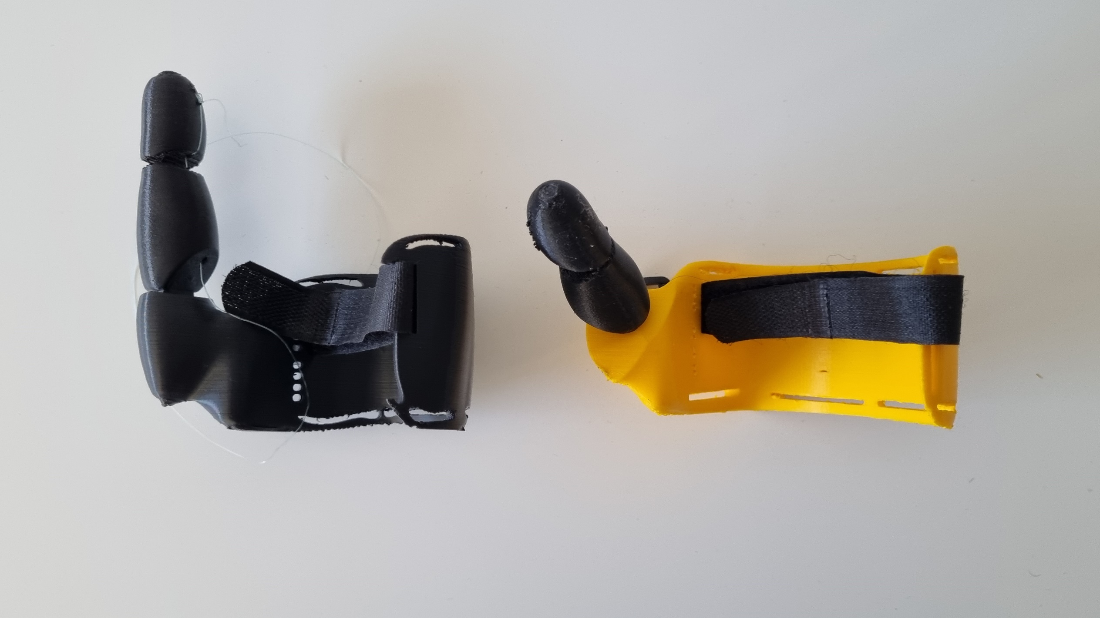
Exo-Prostethis Evolution
Thumb Evolution
Hand Support Evolution

Slide 4
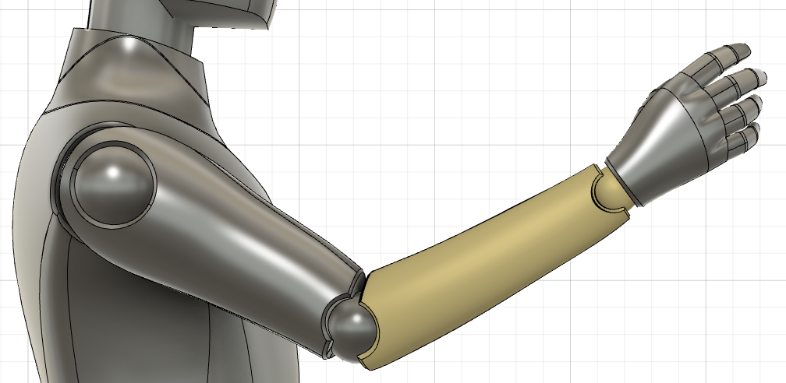
MOTION
Finger Tendons
Velcro Strap
Opening/Closing hand related to the elbow movement
The motion is trasmitted by tendos that runs form the forarm to the finger
Arm extension cause hand grasping
Main Tendon

Slide 5
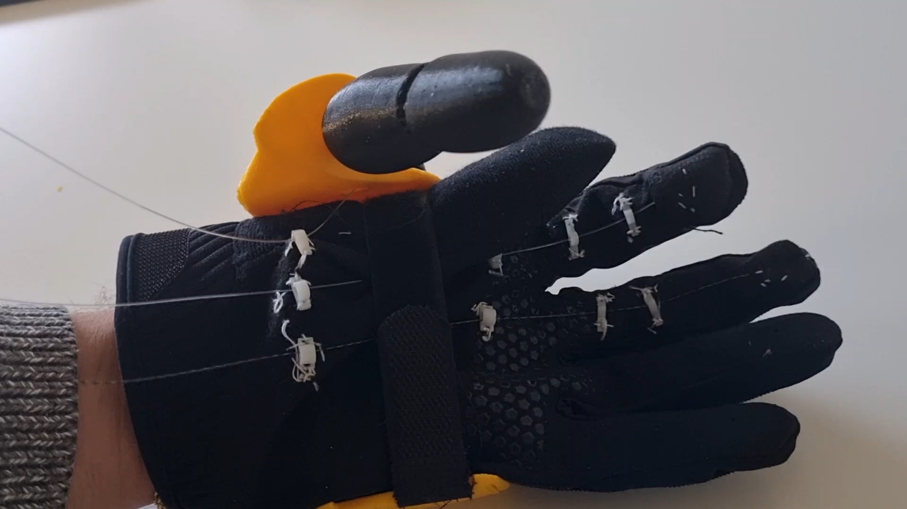
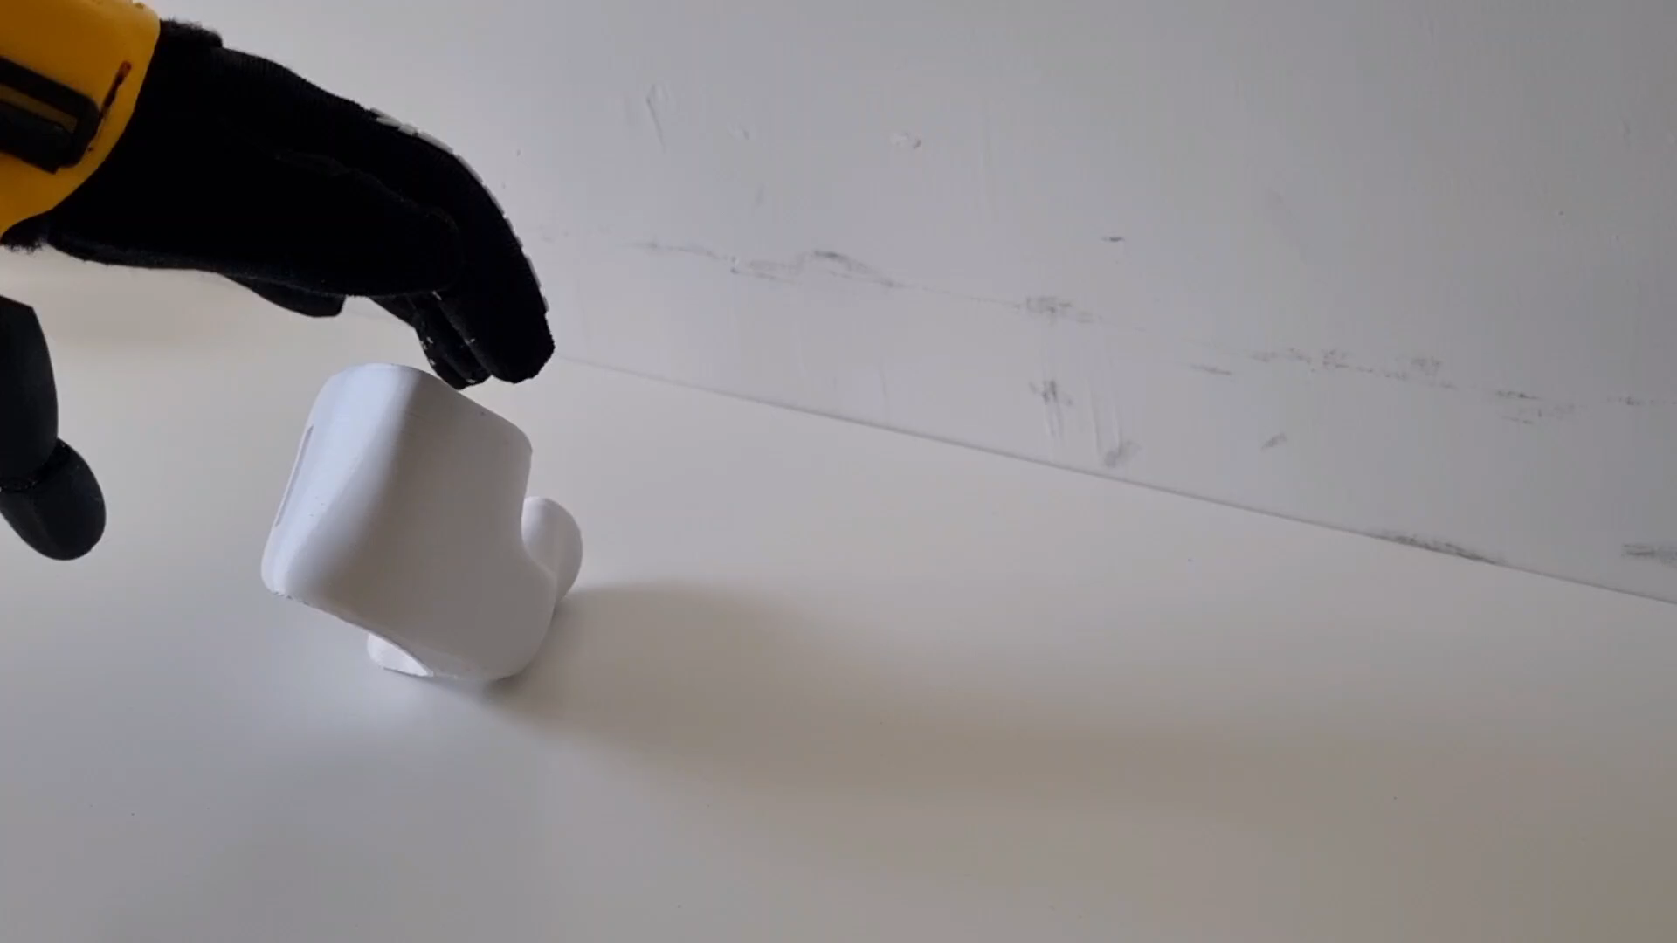
MOTION

Slide 6
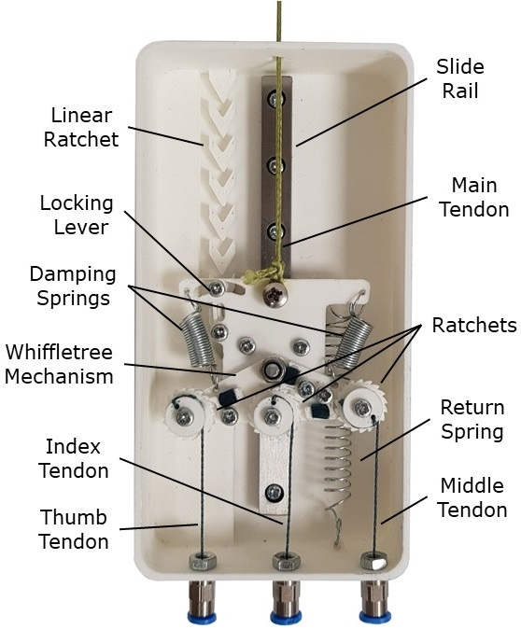
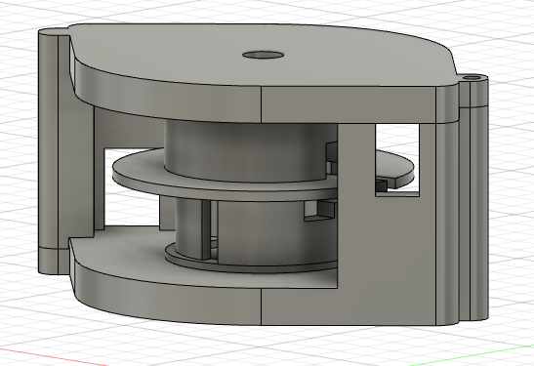
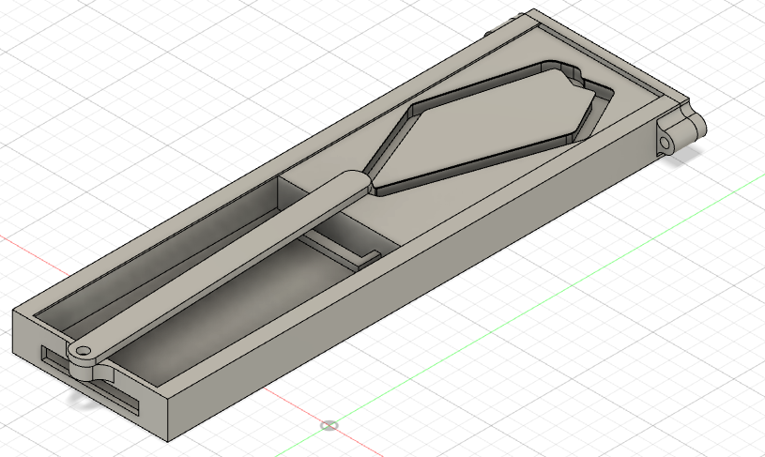
LOCK GRASPING SYSTEM
Goal
Keep the graping during the arm movements
Possible solutions
Open Bionics Locker
Circular Locker
Linear Locker

